Slide 1
Advanced RNN
Chapter 6

Slide 2
What we will cover
Recurrent dropout
Stacking recurrent layers
Bidirectional recurrent layers

Slide 3
Weather Time-Series Data
14 different variables
Recorded every 10 minutes for several years
Limit consideration to 2009-2016

Slide 4
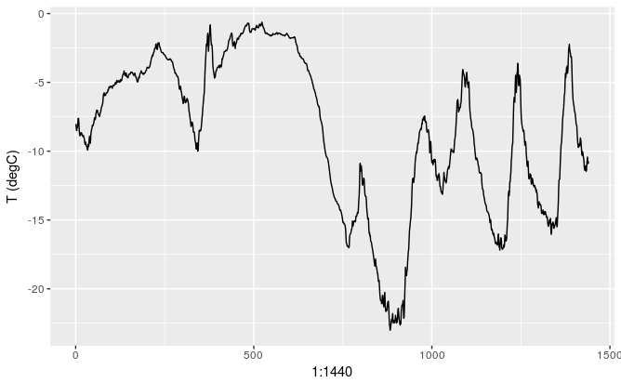
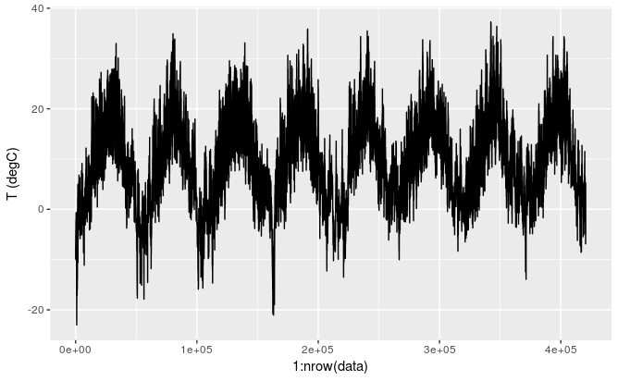
A Look at the Data
First ten days of temperature data
Is the timeseries predictable at the daily scale?
Notes:
(since the data is recorded every ten minutes, we get 144 data points per day):

Slide 5
Data Preparation
Given data going as far back as lookback timesteps (a timestep is 10 minutes) and sampled every steps timesteps, can we predict the temperature in delay timesteps?
lookback = 1440, i.e. our observations will go back 10 days.
steps = 6, i.e. our observations will be sampled at one data point per hour.
delay = 144, i.e. our targets will be 24 hours in the future.

Slide 6
Data Preparation (cont.)
Preprocess the data to a format a neural network can ingest.
Normalize the data
Write a generator function that takes the current array of float data and yields batches of data from the recent past, along with a target temperature in the future.
Notes:
Because the samples in the dataset are highly redundant (sample N and sample N + 1 will have most of their timesteps in common), it would be wasteful to explicitly allocate every sample. Instead, you’ll generate the samples on the fly using the original data.

Slide 7
Instantiate Generators for Training/Valid/Test
lookback <- 1440
step <- 6
delay <- 144
batch_size <- 128
train_gen <- generator(
data,
lookback = lookback,
delay = delay,
min_index = 1,
max_index = 200000,
shuffle = TRUE,
step = step,
batch_size = batch_size
)
val_gen = generator(
data,
lookback = lookback,
delay = delay,
min_index = 200001,
max_index = 300000,
step = step,
batch_size = batch_size
)
test_gen <- generator(
data,
lookback = lookback,
delay = delay,
min_index = 300001,
max_index = NULL,
step = step,
batch_size = batch_size
)
Notes:
data – The original array of floating-point data, which you normalized in listing 6.32.
lookback – How many timesteps back the input data should go.
delay – How many timesteps in the future the target should be.
min_index and max_index – Indices in the data array that delimit which timesteps to draw from. This is useful for keeping a segment of the data for validation and another for testing.
shuffle – Whether to shuffle the samples or draw them in chronological order.
batch_size – The number of samples per batch.
step – The period, in timesteps, at which you sample data. You’ll set it 6 in order to draw one data point every hour.

Slide 8
Baseline Performance
Predict that the temperature 24 hours from now will be equal to the temperature right now
Evaluate using MAE, which is 0.29
This translates to a temperature of 0.29 * Std = 2.75 C
Notes:
Excerpt From: François Chollet. “Deep Learning with R MEAP V01.” Apple Books.

Slide 9
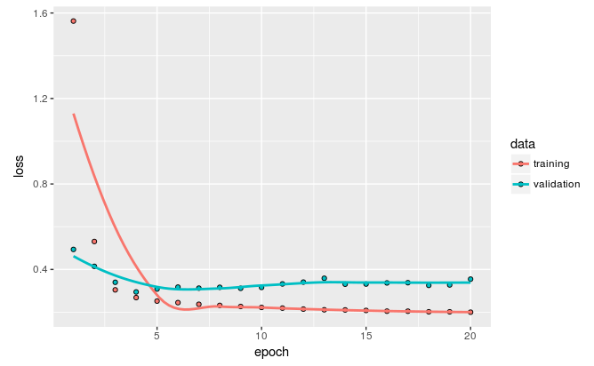
A Simple ML Approach
model <- keras_model_sequential() %>%
layer_flatten(input_shape = c(lookback / step, dim(data)[-1])) %>%
layer_dense(units = 32, activation = "relu") %>%
layer_dense(units = 1)
Notes:
When looking for a solution with a space of complicated models, the simple well-performing baseline might be unlearnable, even if it’s technically part of the hypothesis space.

Slide 10
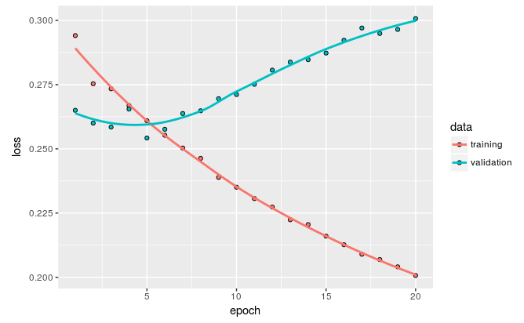
First RNN Model
model <- keras_model_sequential() %>%
layer_gru(units = 32, input_shape = list(NULL, dim(data)[[-1]])) %>%
layer_dense(units = 1)
model %>% compile(
optimizer = optimizer_rmsprop(),
loss = "mae"
)

Slide 11
Using Recurrent Dropout
Different from regular dropout
Same dropout mask should be applied at each timestamp
In order to regularize the representations formed by the recurrent gates of layers such as GRU and LSTM, a temporally constant dropout mask should be applied to the inner recurrent activations of the layer (a “recurrent” dropout mask).

Slide 12
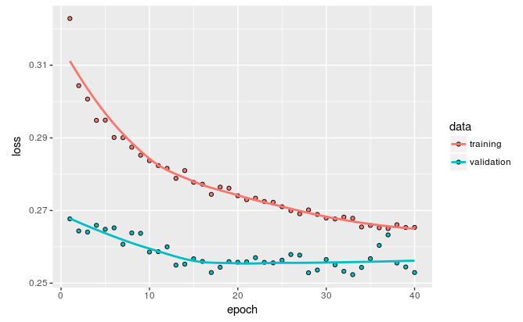
Recurrent Dropout Results
model <- keras_model_sequential() %>%
layer_gru(units = 32, dropout = 0.2, recurrent_dropout = 0.2,
input_shape = list(NULL, dim(data)[[-1]])) %>%
layer_dense(units = 1)
model %>% compile(
optimizer = optimizer_rmsprop(),
loss = "mae"
)
Notes:
we are no longer overfitting during the first 30 epochs. However, while we have more stable evaluation scores, our best scores are not much lower than they were previously.

Slide 13
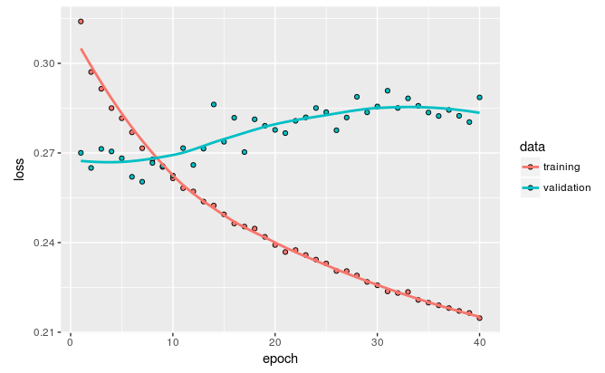
Stacking Recurrent Layers
model <- keras_model_sequential() %>%
layer_gru(units = 32,
dropout = 0.1,
recurrent_dropout = 0.5,
return_sequences = TRUE,
input_shape = list(NULL, dim(data)[[-1]])) %>%
layer_gru(units = 64, activation = "relu",
dropout = 0.1,
recurrent_dropout = 0.5) %>%
layer_dense(units = 1)
model %>% compile(
optimizer = optimizer_rmsprop(),
loss = "mae"
)
Notes:
Diminishing returns on stacking layers

Slide 14
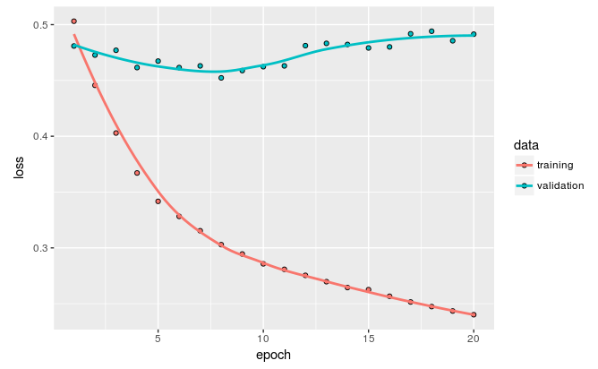
Bidirectional RNNs
Process data in antichronological order
Rewrite generator

Slide 15
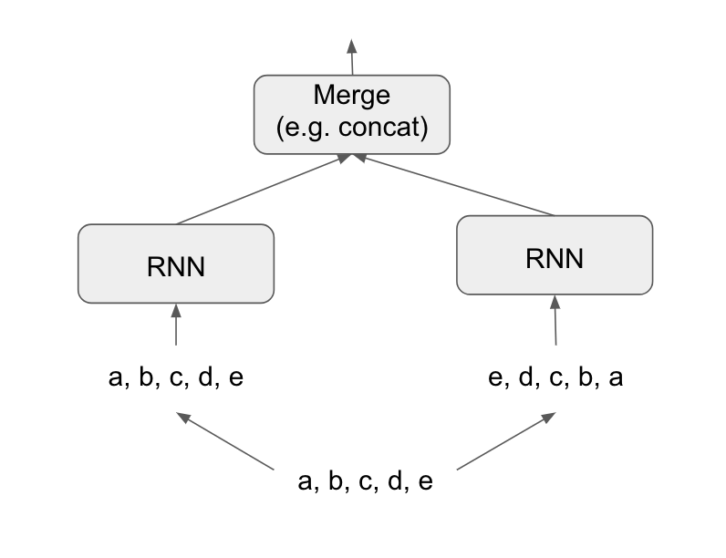
How Bidirectional RNNs work
model <- keras_model_sequential() %>%
layer_embedding(input_dim = max_features, output_dim = 32) %>%
bidirectional(
layer_lstm(units = 32)
) %>%
layer_dense(units = 1, activation = "sigmoid")
model %>% compile(
optimizer = "rmsprop",
loss = "binary_crossentropy",
metrics = c("acc")
)
Notes:
Question: Why can’t we apply this for stock prediction

Slide 16
Sequence Processing with Convnets
“The same properties that make convnets excel at computer vision also make them highly relevant to sequence processing. Time can be treated as a spatial dimension, like the height or width of a 2D image.”
Notes:
Excerpt From: François Chollet. “Deep Learning with R MEAP V01.” Apple Books.

Slide 17
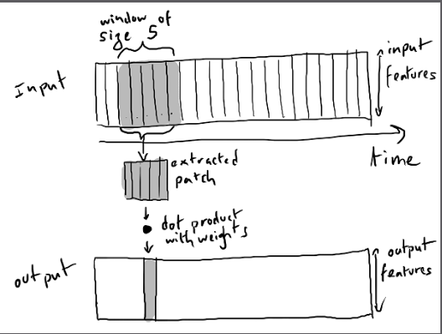
1D Convnet
A 1D convnet takes as input 3D tensors with shape (samples, time, features) and returns similarly shaped 3D tensors. The convolution window is a 1D window on the temporal axis: the second axis in the input tensor
Notes:
Excerpt From: François Chollet. “Deep Learning with R MEAP V01.” Apple Books.

Slide 18
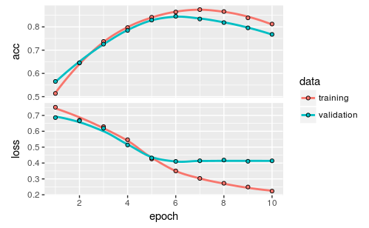
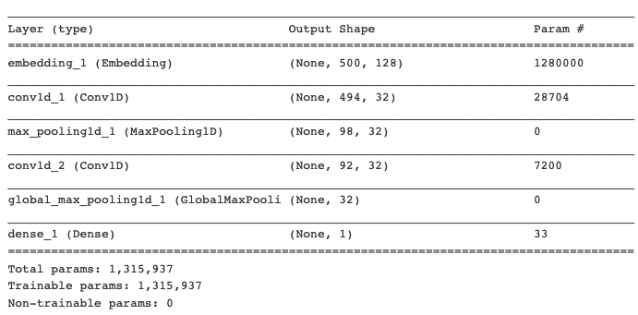
Example - IMDB
model <- keras_model_sequential() %>%
layer_embedding(input_dim = max_features, output_dim = 128,
input_length = max_len) %>%
layer_conv_1d(filters = 32, kernel_size = 7, activation = "relu") %>%
layer_max_pooling_1d(pool_size = 5) %>%
layer_conv_1d(filters = 32, kernel_size = 7, activation = "relu") %>%
layer_global_max_pooling_1d() %>%
layer_dense(units = 1)
summary(model)
Notes:
validation accuracy is somewhat lower than that of the LSTM we used two sections ago, but runtime is faster, both on CPU and GPU

Slide 19
Class Exercise - Weather Forecasting
Use any or all of the methods to improve weather forecasting for the problem we discussed in class. For example, by adjusting the number of units in each recurrent layer in the stacked setup, or using layer_lstm() instead of layer_gru().
You can also try experimenting with a combination of 1d_convnets and rnn.
Don’t forget to eventually run the best-performing models (in terms of validation MAE) on the test set!

